Slide 1

Department of Information Technology NBA Accredited
A.P. Shah Institute of Technology G.B.Road,Kasarvadavli, Thane(W), Mumbai-400615
UNIVERSITY OF MUMBAI
Academic Year 2021-2022

Slide 2
Developing AI-Based Comprehensive Framework for Online Assessments
Submitted in partial fulfillment of the degree of
A Project Presentation on
Bachelor of Engineering(Sem-8) in
INFORMATION TECHNOLOGY
By
Swapnil Sapre(18104027) Kunal Shinde(18104012) Keval Shetta(18104013)
Under the Guidance of Prof Vishal Badgujar

Slide 3
1.Project Conception and Initiation

Slide 4
1.1 Abstract
Online examinations are the way of conducting examinations on the user’s mobile devices or laptops rather than actual paper. During situations when physical exams cannot be conducted online exams have been the preferred
choice.
In physical examinations the students doing malpractices reduces by a great amount as there are examiners physically present to monitor every student. The idea of our examination framework is to reduce the malpractices done by the students in the online mode as far as the current platforms in use are
concerned.
We have arrived at conclusion that Smart Online Examination platform is a much viable solution to the existing platforms for conduction of the exams and doing the proctoring.

Slide 5
1.2 Objectives
To set up proctoring mechanism to stop malpractices in exam. To create a system that validates each user well before the exam using facial recognition and validation.
To perform object tracking (person tracking) throughout the exam.
To allow the examiner to alert warnings or end the exam if students found performing malpractices.
To provide a platform for the teachers to set the questions and get detailed reporting.
To provide tab locking features to not allow students to navigate away from exam screen.
To send attendance and mis activity report details to teacher's.

Slide 6
1.3 Literature Review
Sr. No | Authors | Publication | Findings
1 | Walaa M. Abd-Elhafiez, Mohamed Heshmat, and Seham Elaw | Title : Efficient Method for Face Recognition and Its Role in Supporting E-Learning Systems Year : IEEE , 2015 Conference : Fifth International Conference on e-Learning (econf), 2015 | Facial feature detection algorithm which is needed to detect the face of the candidate from several image sets. Detection required calculation of the three components in the face image like eyes, nose, and mouth and the extraction of these features
2 | Arief Agus Sukmandhani and Indrajani Sutedja | Title : Face Recognition Method for Online Exams Year : IEEE , 2019 Conference : 2019 International Conference on Information Management and Technology (ICIMTech), 2019 | CNN (Convolutional Neural Networks) a deep learning algorithm helps in face verification and detection. Requires training samples by taking number of sample data of student faces

Slide 7
Sr. No | Authors | Publication | Findings
3 | Samuel S. Chua et | Title : Online Examination System with Cheating Prevention Using Question Bank Randomization and Tab Locking Year : IEEE , 2019 Conference : 2019 4th International Conference on Information Technology (InCIT) | Tab locking mechanism that prevents candidates from opening other as their exam window is locked while the exam is in progress. Having randomized system for question papers so students do not get the same questions
4 | Arief Agus Sukmandhani and Indrajani Sutedja | Title : Face Recognition Method for Online Exams Year : IEEE , 2019 Conference : 2019 International Conference on Information Management and Technology (ICIMTech), | Deep face is a deep learning python-based framework that can detect faces from images and has already been trained with sample images.
5 | Mansi Mahendru and Sanjay Kumar Dubey | Title : Real Time Object Detection with Audio Feedback using Yolo vs. Yolov3 Year : IEEE , 2021 Conference : 2021 11th International Conference on Cloud Computing, Data Science & Engineering (Confluence) | YOLO is a machine learning algorithm that is used to perform object detection It can be used to detect objects in still images, provided sample video, or from a real-time webcam

Slide 8
1.4 Problem Definition
Problems Identified :
Inability to conduct in person exams in situations like pandemic.
Malpractices done by students by taking advantage of no proctoring methods during exam.
Personal monitoring of students required that takes more time and not easily manageable
Problem of Impersonation
Student management in terms of marks record and question bank management in terms of setting question paper.

Slide 9
1.5 Scope
Can be applied in educational institutes like schools and colleges for conduction of tests.
Can be used anytime and anywhere.
Can be used by teachers to conduct any kind of tests and having different kinds of question patterns.

Slide 10
1.6 Technology stack
HTML , CSS , Javascript – for building web application.
Flask – Python web based lightweight framework
Python – For server side processing.
YOLO – Machine Learning algorithm for object detection
DeepFace – For face validation
MySQL – Xampp : localhost server to run the application.

Slide 11
1.7 Benefits for environment & Society
Proctored testing removes administrative burden on test centers
Proctoring creates a fair online test environment for students.
Proctored testing features prevent and deter malpracticing.
Proctoring online examination avoids the use of pen and paper and saves time.

Slide 12
2. Project Design

Slide 13
2.1 Proposed System
Student Block/Dashboard
To attempt the test.
To check the result of the attempted test.
Examiner Block/Dashboard
To create test
To add/update/delete questions
Question Paper Generation Process
By importing a document file having test questions in it.

Slide 14
Object Tracking and Face recognition
During login into system , face recognition and validation is performed.
During examination, tracking of the student's live environment.
Tab Locking
Display of alert message when student navigates away from the exam window.
Exam terminates after 5 attempts.

Slide 15
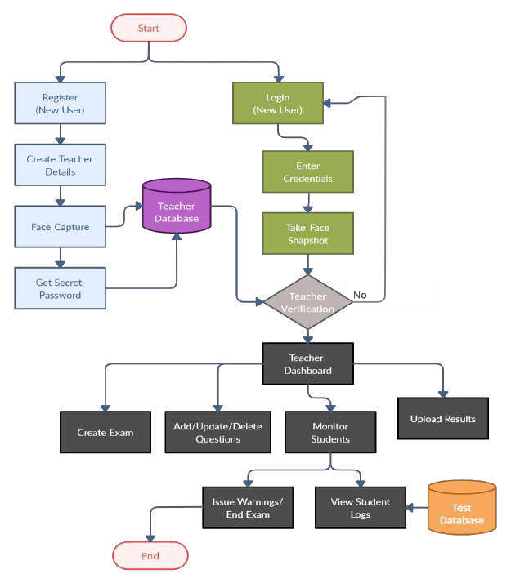
2.2 Design(Flow Of Modules)
1. Examiner's (Teacher's) End

Slide 16
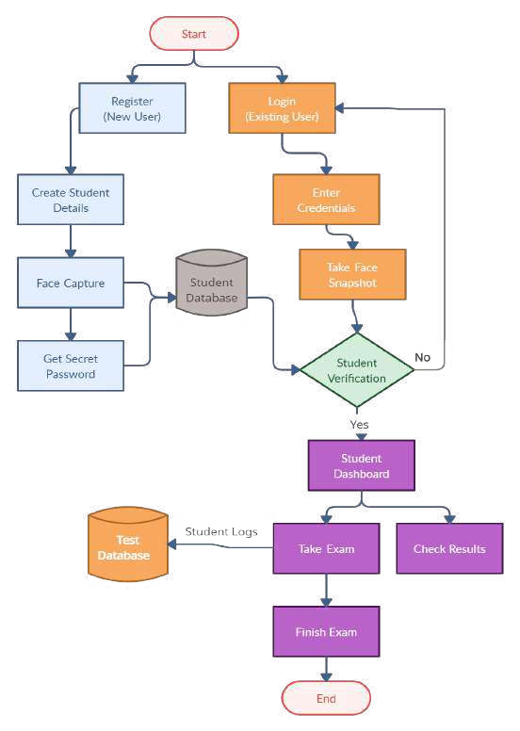
2.2 Design(Flow Of Modules)
2. Student's End

Slide 17
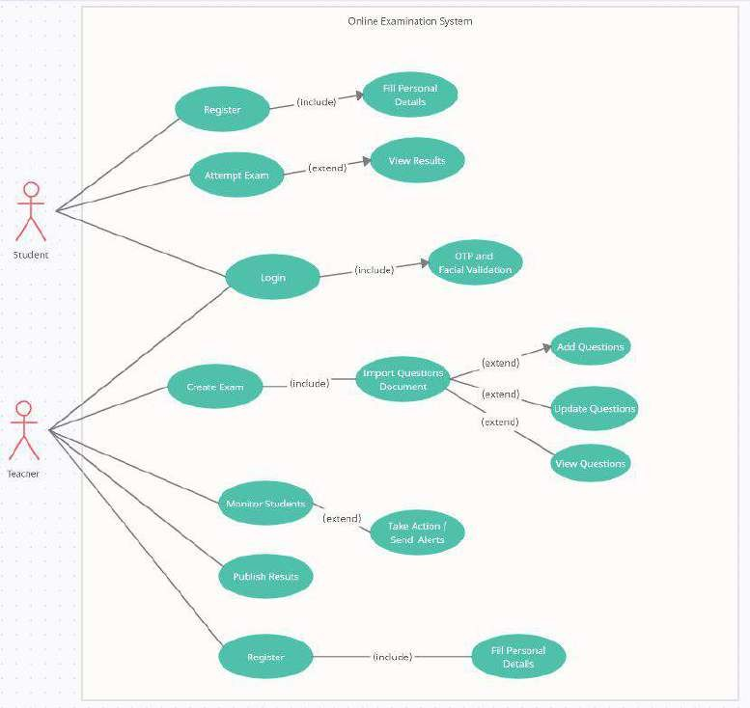
2.3 Description Of Use Case

Slide 18
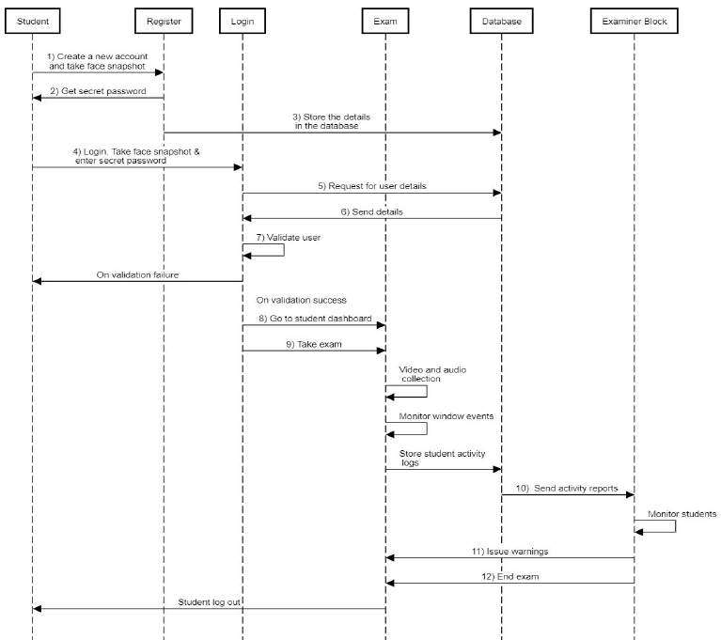
2.4 Activity diagram
1) Student's End

Slide 19
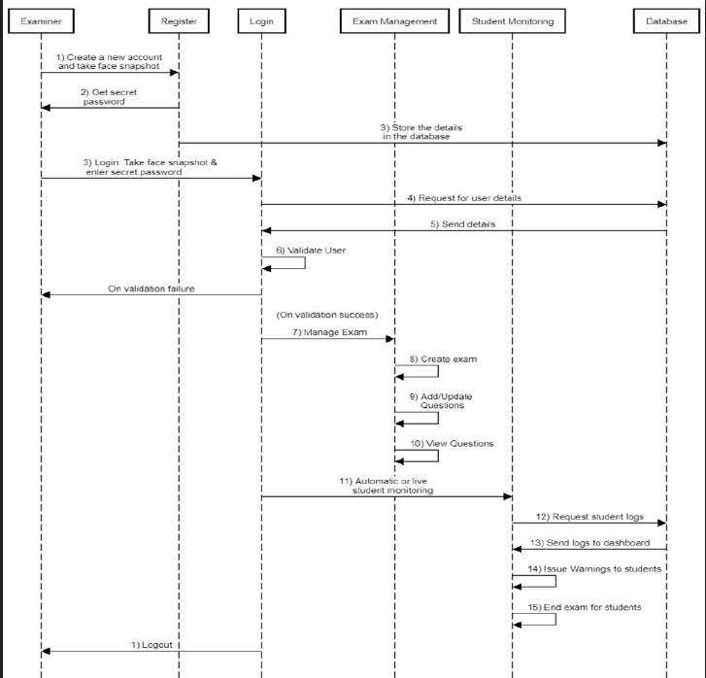
2.4 Activity diagram
1) Teacher's End

Slide 20
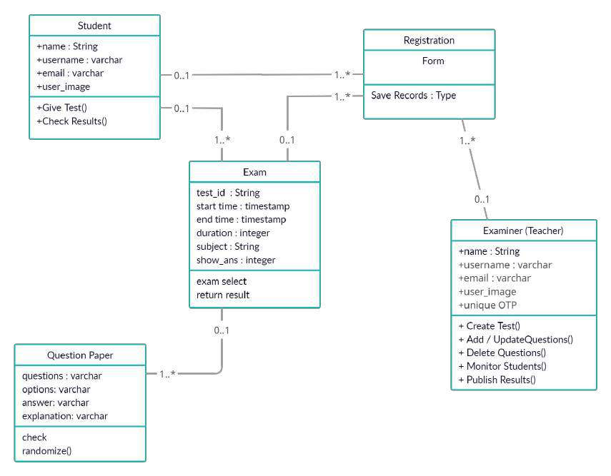
2.5 Class Diagram

Slide 21
3. Implementation
Implementation

Slide 22
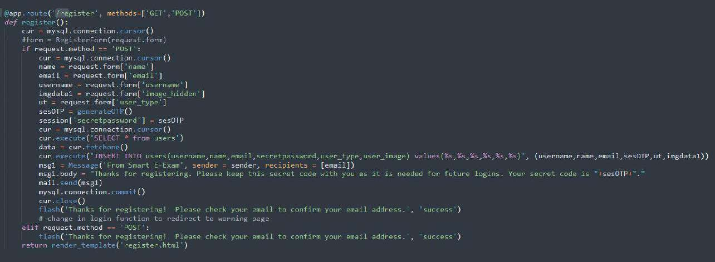
(1) Register

Slide 23
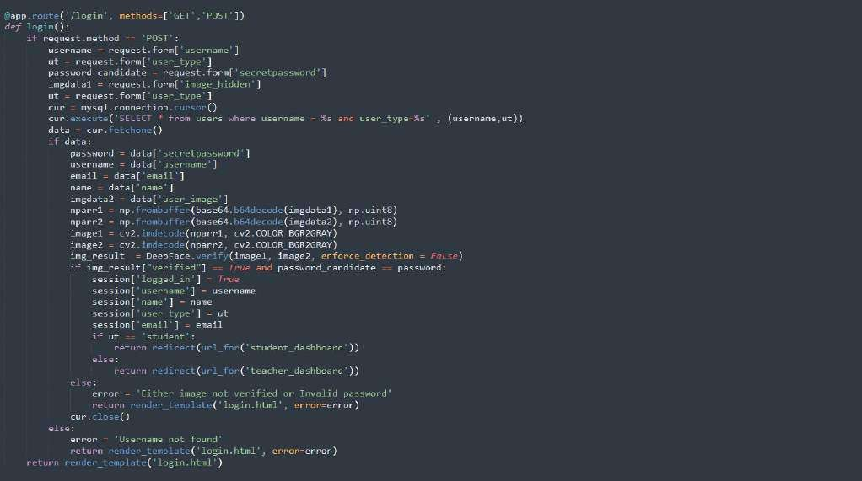
(2) Login

Slide 24
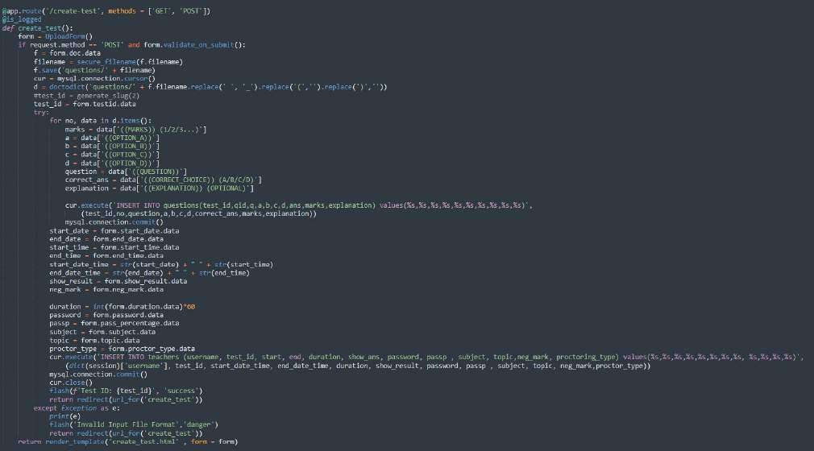
(3) Create Test

Slide 25
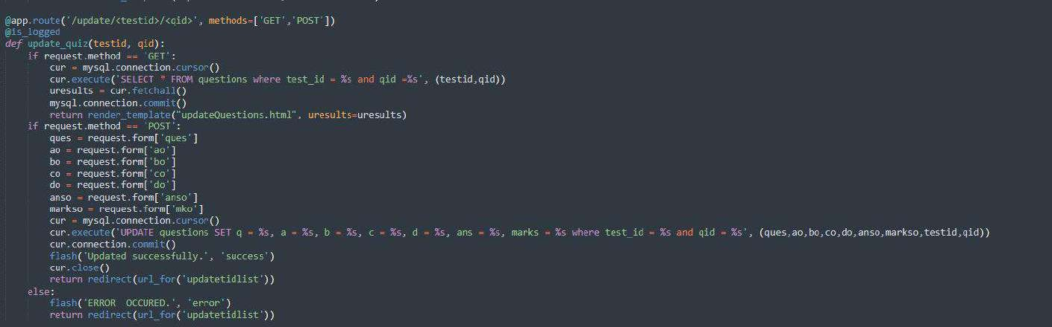
(4) Update Questions

Slide 26
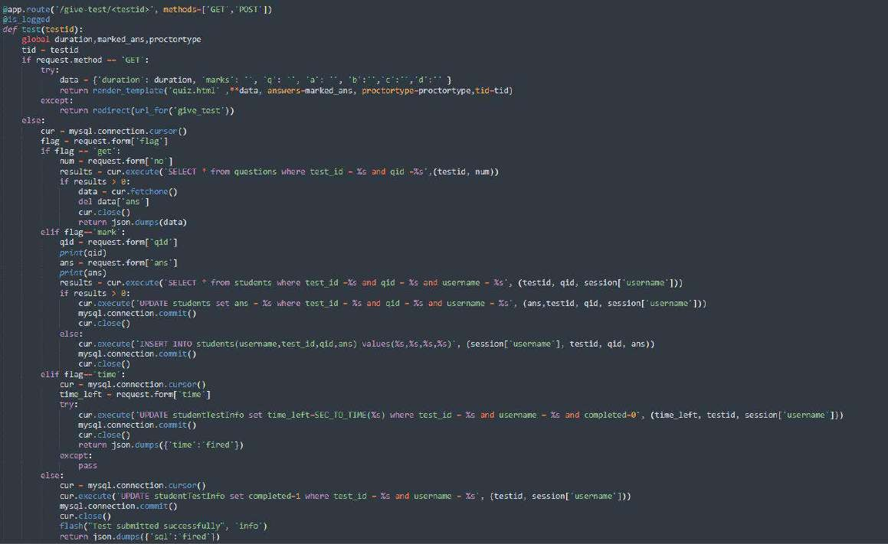
(5) Give Test

Slide 27
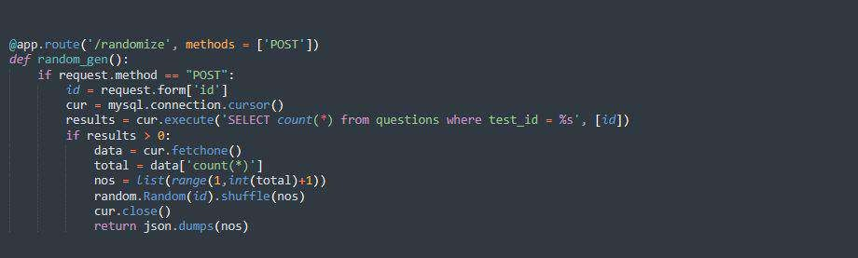

(6) Randomize Questions in test
(7) Generation of secret password (OTP)

Slide 28
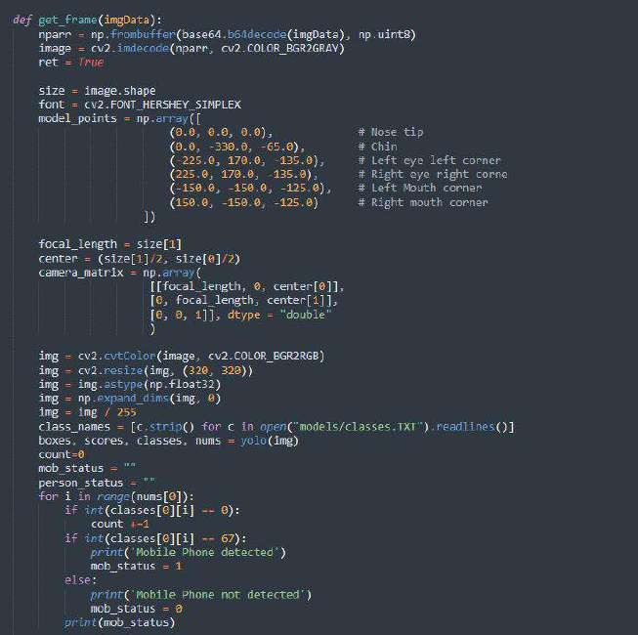
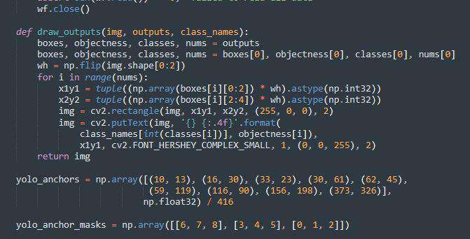
(8) Applying boundary box around captured face
(9) Mobile detection ML code

Slide 29
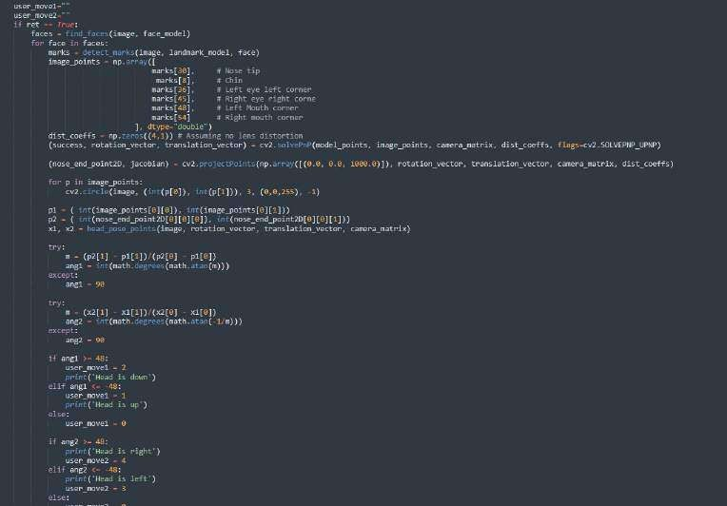
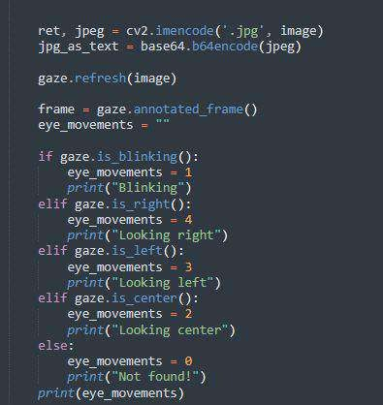
(10) User movement detection ML code
(11) Eye tracking detection ML code

Slide 30
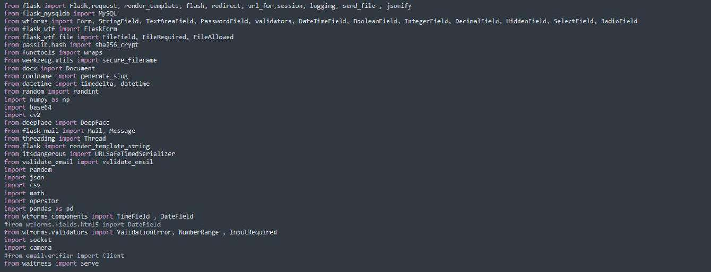
(12) Libraries used

Slide 31
4. Testing

Slide 32
Unit Testing
Unit testing has been used as our main testing method.
It is a testing process that tests individual components of the application in terms of its functionality and working.
Our application have many small units like
Login and registration
creation of exam
Adding - updating questions
monitoring the students
Attempting test and checking results
Log generation.
Helps finding issues in individual components at early stage.

Slide 33
5. Result
Two-factor authentication which is the combination of secret password and the face validation at the time of login for both the examiners and the students.
Log generation of all the student's activities done in the exam.
Easy exam generation process for the exam creation and its management.
Can detect all the window and user movements but difficult to analyze front view of
the candidate.

Slide 34



(a) Registered User in system
(b) Different User logging in system
(c) Face validation error message
Fig 1. Face capture and validation process.
This shows registration process in which user in (a) captures their image. However a different user shown in (b) tries to login which result to images not getting validated. So the system displays the error to the user as image not verified.

Slide 35
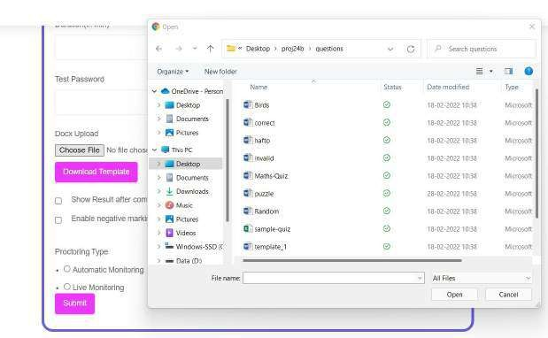
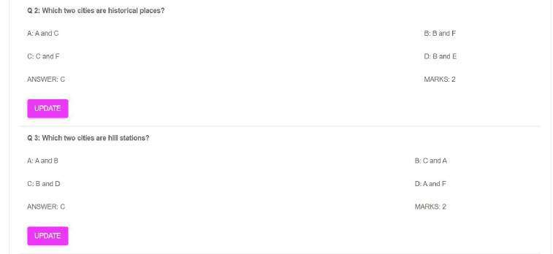
(a) Importing questions from document file
(b) Updating questions of the exam
Fig 2. Exam generation process.
This shows a document file containing questions being uploaded in (a).
Part (b) shows teacher can later update the questions, options, marks, etc. by clicking respective question.

Slide 36
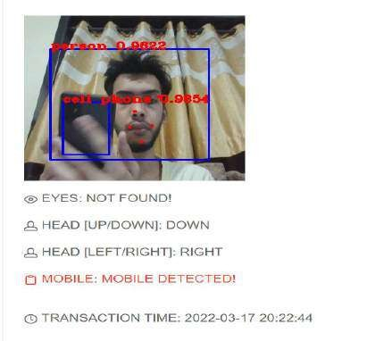
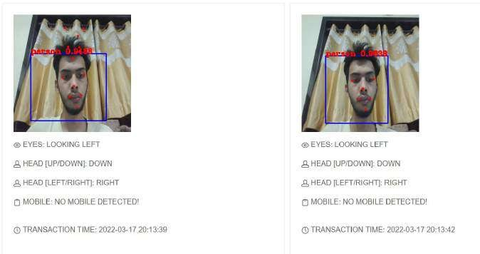
(a) Logs generation
The student logs are displayed on teacher’s dashboard after analyzing.
(b) Mobile detection
Student is using mobile and it gets detected
And shown as log

Slide 37
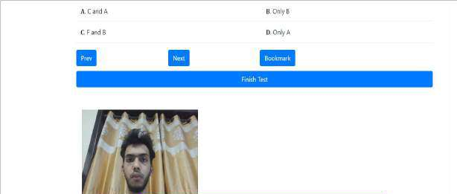
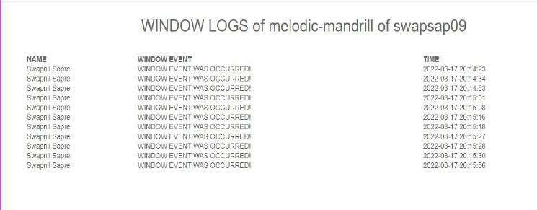
(c) Alert on tab switching
Student performed tab navigation so system
displayed alert message
(d) Tab switching activity
All the tab navigation attempts are shown as logs along with date and time

Slide 38
6. Conclusion and Future Scope
Face detection by capturing the face snapshot of the user and verification of it.
Able to perform student tracking throughout the exam and generating alert.
Able to detect the objects in the candidate's live environment and generate reports.
Future Scope
To extend the examination to subjective based questions as well.
future scope of this work is to make the entire system a part of the e-learning framework and also provide support for practical as well as subjective-based examinations.
In future it aims to collect the background noise coming from the student’s live environment and analyze it.

Slide 39
References
Walaa M. Abd-Elhafiez, Mohamed Heshmat, and Seham Elaw. Efficient Method for Face Recognition and Its Role in Supporting E-Learning Systems. 2015. doi: 10.1109/ECONF.2015.21.
Wang Aimin and Wang Jipeng. Design and Implementation of Web-Based Intelligent Examination System. 2009. doi: 10. 1109/WCSE.2009.77.
Hadian S. G. Asep and Yoanes Bandung. A Design of Continuous User Verification for Online Exam Proctoring on MLearning. 2019. doi: 10.1109/ICEEI47359.2019.8988786.
Yousef Atoum et al. Automated Online Exam Proctoring. 2017. doi: 10.1109/TMM.2017.2656064
Samuel S. Chua et al. Online Examination System with Cheating Prevention Using Question Bank Randomization and Tab Locking. 2019.
Radhika C. Damale and Bazeshree. V Pathak. Face Recognition Based Attendance System Using Machine Learning Algorithms. 2018. doi: 10.1109/ICCONS.2018.8662938.
Jegatha Deborah L et al. Secure Online Examination System for e-learning. 2019. doi: 10.1109/CCECE43985.2019. 9052408.
Ondrej Kainz et al. Enhancing Attention through the Eye Tracking. 2020. doi: 10.1109/ICETA51985.2020.9379229.
Mansi Mahendru and Sanjay Kumar Dubey. Real Time Object Detection with Audio Feedback using Yolo vs. Yolov3. 2021. doi: 10.1109/Confluence51648.2021.9377064.
Arief Agus Sukmandhani and Indrajani Sutedja. Face Recognition Method for Online Exams. 2019. doi: 10.1109/ICIMTech.
2019.8843831.

Slide 40
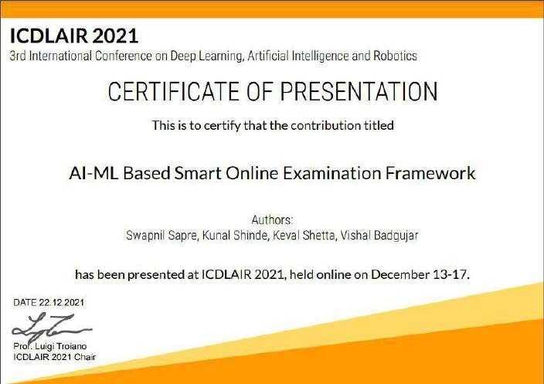
Paper Publication
Conference: 3rd International Conference on Deep Learning, Artificial Intelligence and Robotics (ICDLAIR) 2021
Journal: Springer LNNS
Published By: Swapnil Sapre , Kunal Shinde , Keval Shetta

Slide 41
Thank You

